Slide 1
Save the Children’s Organizational Strategy for mHealth
mHealth Working Group
22 May, 2012
Jeanne Koepsell
Save the Children

Slide 2
Outline
Background on Save the Children
Rationale
Process
Components

Slide 3
Save the Children

Slide 4
Who we are
Save the Children – a leading independent organization for children
In ~120 countries, including the US
29 member organizations
Work in several areas:
  Health and Nutrition
  Livelihoods
  Education
  Emergencies

Slide 5
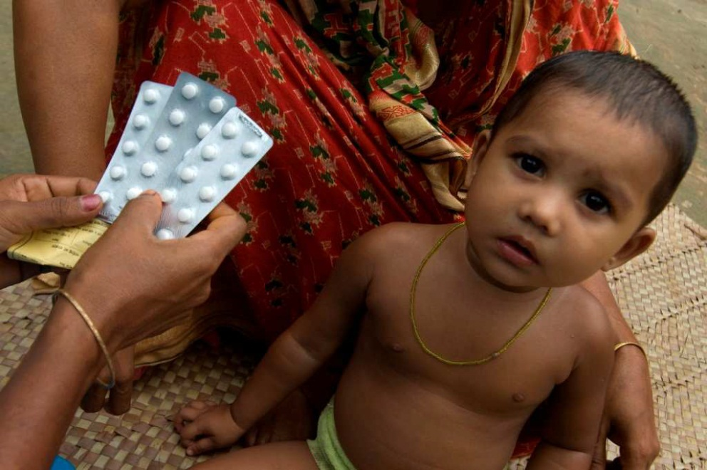
SC’s Department of Health and Nutrition - vision
Mothers and their children have access to and use high impact, evidence-based health and nutrition services and adopt healthy behaviors, in both development and emergency situations.

Slide 6
SC’s Department of Health and Nutrition – areas of expertise
Adolescent Sexual & Reproductive Health (ASRH);
Behavior Change Communication (BCC);
Child Survival (CS);
Community Case Management (CCM);
Emergency Health & Nutrition (EHN);
Health System Strengthening (HSS);
Maternal, Newborn & Child Health (MNCH);
Nutrition.

Slide 7
Rationale

Slide 8
Rationale for developing an mHealth strategy
Save the Children wanted a strategic approach to:
  Integrate mHealth, when applicable, into overall health and nutrition programs
  Develop evidence on how to take mHealth activities to scale and sustain them
In order to improve health outcomes in low-resource settings.

Slide 9
Process

Slide 10
Timeline
2008/2009 – country offices started using PDAs for surveys
2009 – several of us started attending meetings related to mHealth
Late 2009 – thinking about a strategy
2010 – intern (Hannah Tappis) started research and drafting document
2010/2011 – finalized document
Late 2011 – technology retreat

Slide 11
Components of the process – background research
Existing mHealth initiatives and resources exist
  (including mHealth working group!)
SC structure
  Vision
  Results framework
  Priority countries

Slide 12
Components of the process – interviews
Key informants
  Leaders in DHN, emergencies & IT
Potential users of mHealth
  TA providers
  Field staff
Asked:
  Experience we have with technologies?
  What do you know about mHealth?
  What do you want?
  How can we get there?

Slide 13
Components of the process – technology retreat in December 2011
Meeting with TA providers, country staff and stakeholders
Questions to answer:
  What do we want our role to be in the long-term?
    Partnering to help develop new technologies?
    Helping to increase use of important existing technologies?
    Research or fieldwork?
  What added value can we bring, & do we want to bring, to this?
  How do we want to partner?
  How much do we want to invest in this?

Slide 14
Components of the strategy

Slide 15
Outline of document
Save the Children’s Vision and Mission
Introduction
Strategy
Priorities
Action plan

Slide 16
Strategy – Vision for mHealth
Appropriate mHealth technologies be efficiently used at scale to the maximum extent feasible, to increase the quality and use of key interventions and practices for improving maternal, newborn, child, and adolescent health and survival in DHN priority countries.

Slide 17
Strategy – Basic principles of mHealth
Tool for achieving health and nutrition project objectives
Country offices will employ the most suitable mHealth tools
Will develop new partnerships.
Expand Save the Children’s research focus

Slide 18
Strategy – Priorities
  Priorities for expanding the use of mHealth
  Priorities for technical expertise and capacity development
  Priorities for research and learning
  Equipment and infrastructure
  Tools

Slide 19
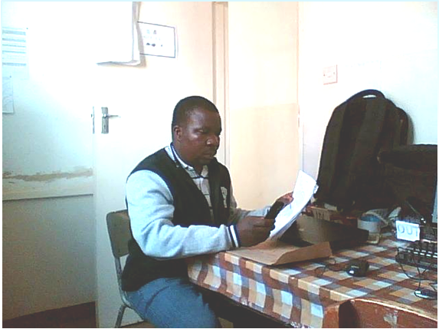
Thank you!

